Slide 1


Slide 2

Menus are a popular means of organizing a large number of options in a form.
Menus can be attached only to forms, and then executed
The items that make up the menu are MenuItem objects.
In Oracle 6i, we can create menus in Forms Builder Application
Each such menu can be saved as an .mmb file and can be compiled to an .mmx file of the same name.
It is the compiled file that is attached to the forms

Slide 3

Options or MenuItems can be made to display other created objects in Oracle 6i such as
  Forms
  Reports
  Charts

Slide 4

Enables the user to view many other forms/objects by executing a single form having such options in its attached menu
Thus, making it very user-friendly and time efficient

Slide 5

Open Form Builder, design a Menu and code the menu items
Save menu file as filename.mmx
Compile the Menu to get filename.mmx (Executable File) and Close the Builder.
Open Form Builder to create the main canvas where the menu is added
Design the main canvas, it should have atleast one control. We will add an Image Control. Resize the control such that the area it has will be the area the image gets to be displayed.
Loading the image: Right-click on the form -> Smart Triggers -> Pre-form
  Code the PL/SQL Editor to load the image
Attaching the menu: Open property pallette -> Functional -> Menu Module.
  Select the filename.mmx menu file
Run the file

Slide 6

It is an in-built functions of Oracle 6i
It runs an indicated form while keeping the parent form active.
This method has the following specification:
PROCEDURE CALL_FORM(
formmodule_name VARCHAR2,
[display NUMBER],
[switch_menu NUMBER]
);

Slide 7

formmodule_name : The name of the called form (must be enclosed in single quotes). Datatype is VARCHAR2.
  Note**: Must include path also if form not stored in default folder
display:
  HIDE (The default.) Form Builder will hide the calling form before drawing the called form.
  NO_HIDE Form Builder will display the called form without hiding the calling form.
switch_menu:
  NO_REPLACE (The default.) Form Builder will keep the default menu module of the calling form active for the called form.
  DO_REPLACE Form Builder will replace the default menu module of the calling form with the default menu module of the called form.

Slide 8

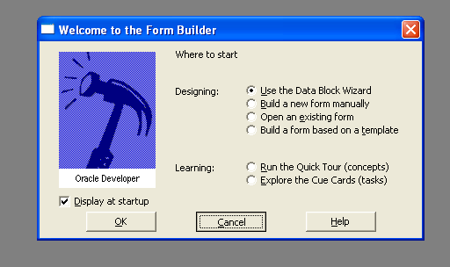
Cancel the Data Block Wizard

Slide 9

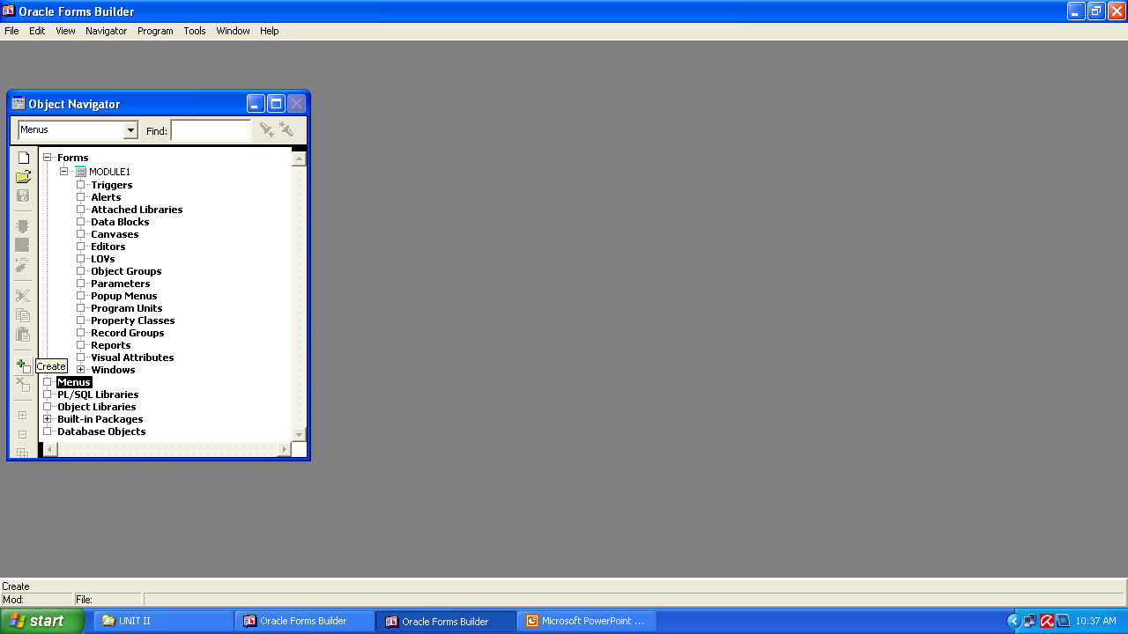
Choose the Menu option and click on the ‘+’ button to create a new menu
Right Click on the created Menu and select Menu Editor for designing

Slide 10

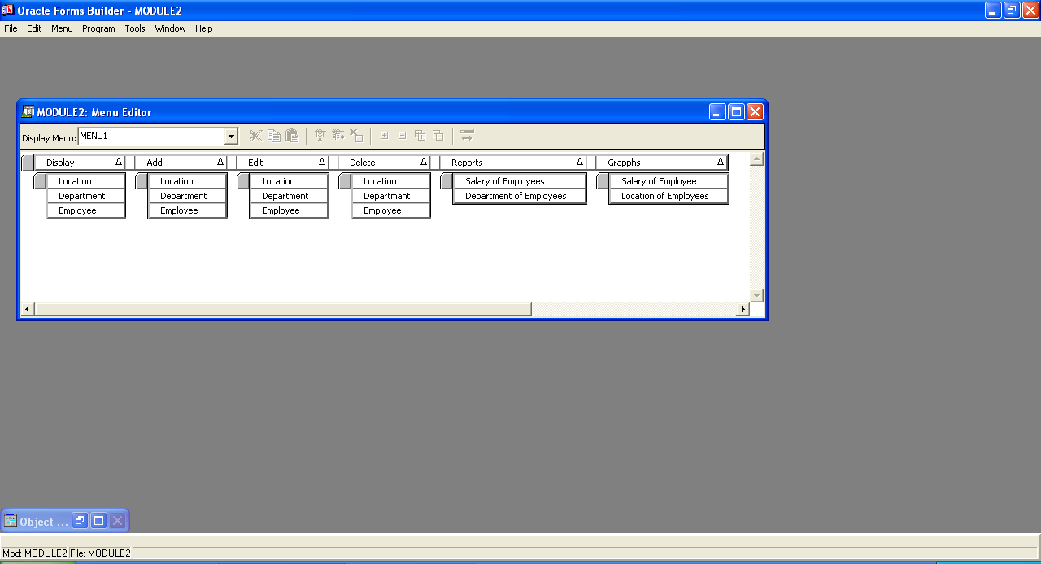
To add another menu option, click on this button
To create a sub-menu below, click on this button

Slide 11

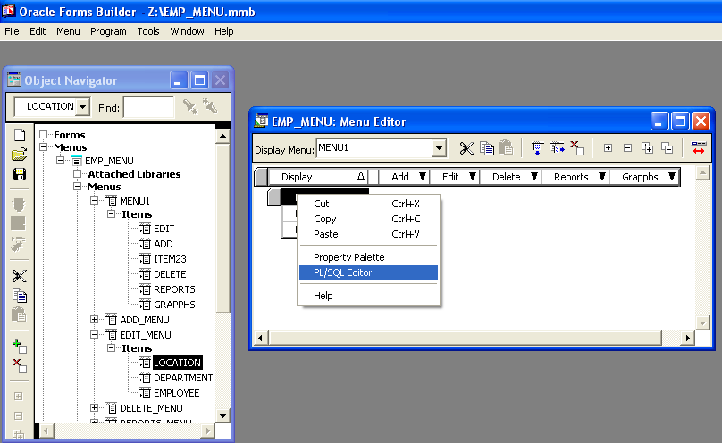

Slide 12

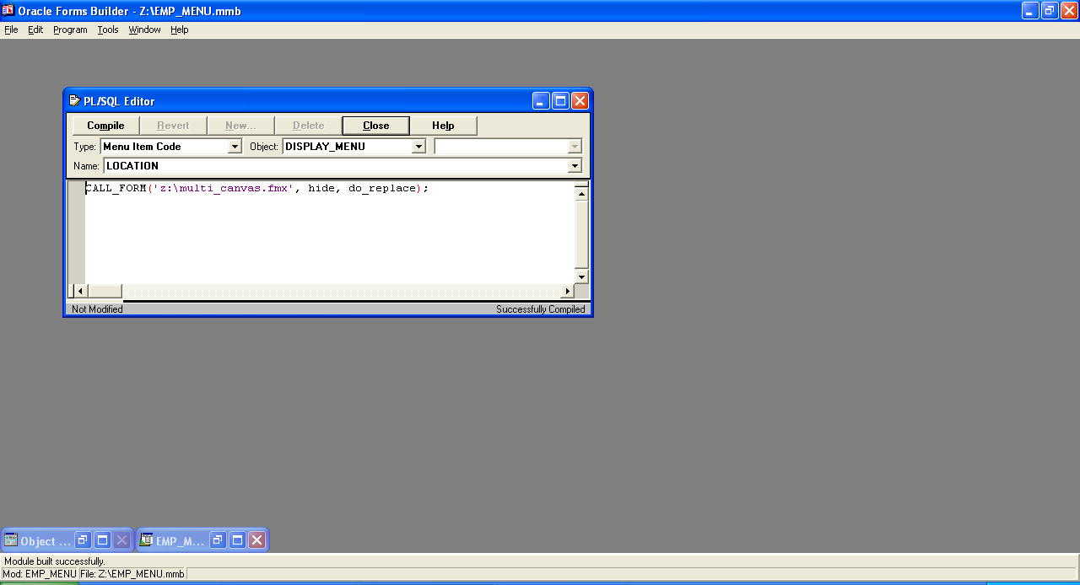

Slide 13

Once the menu is created, save the file as ‘emp_menu.mmb’ and execute it using the File→ Administration → Compile File option.
This will create an executable version of the menu file ‘emp_menu.mmx’.

Slide 14

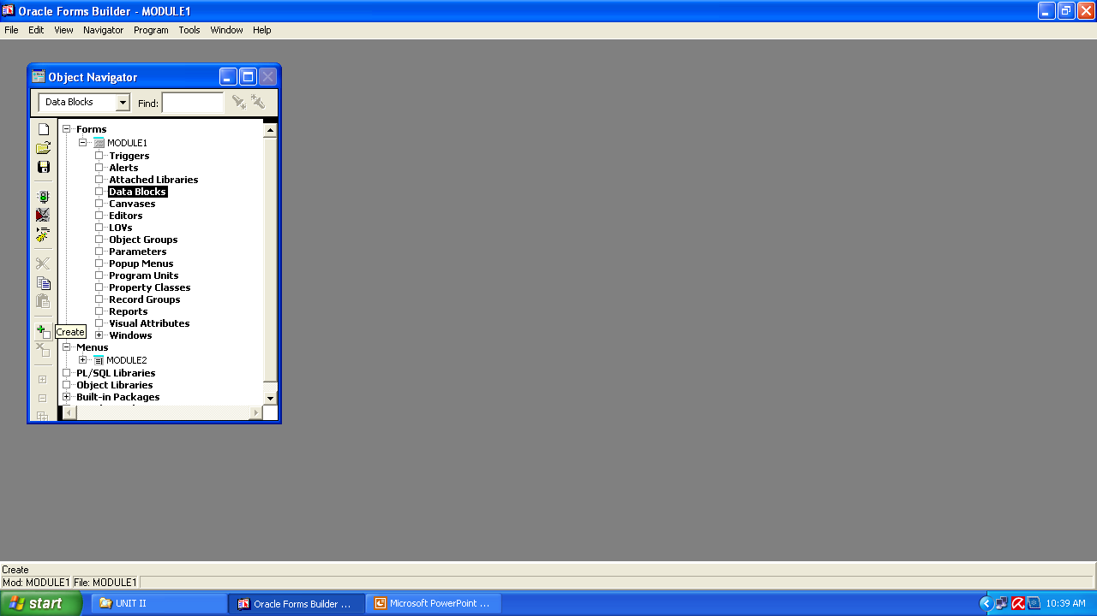
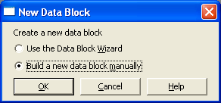
Start new Form Builder and build the data block manually
Open the blank canvas for designing it (Press F2)

Slide 15

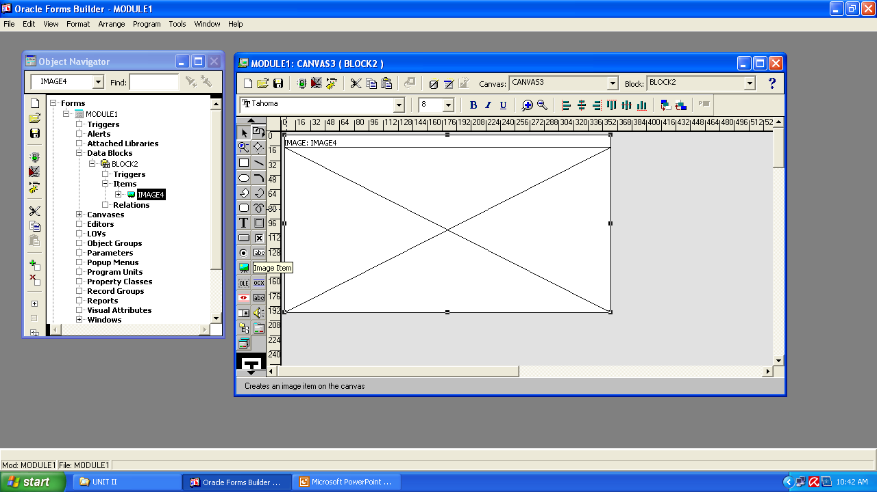

Slide 16

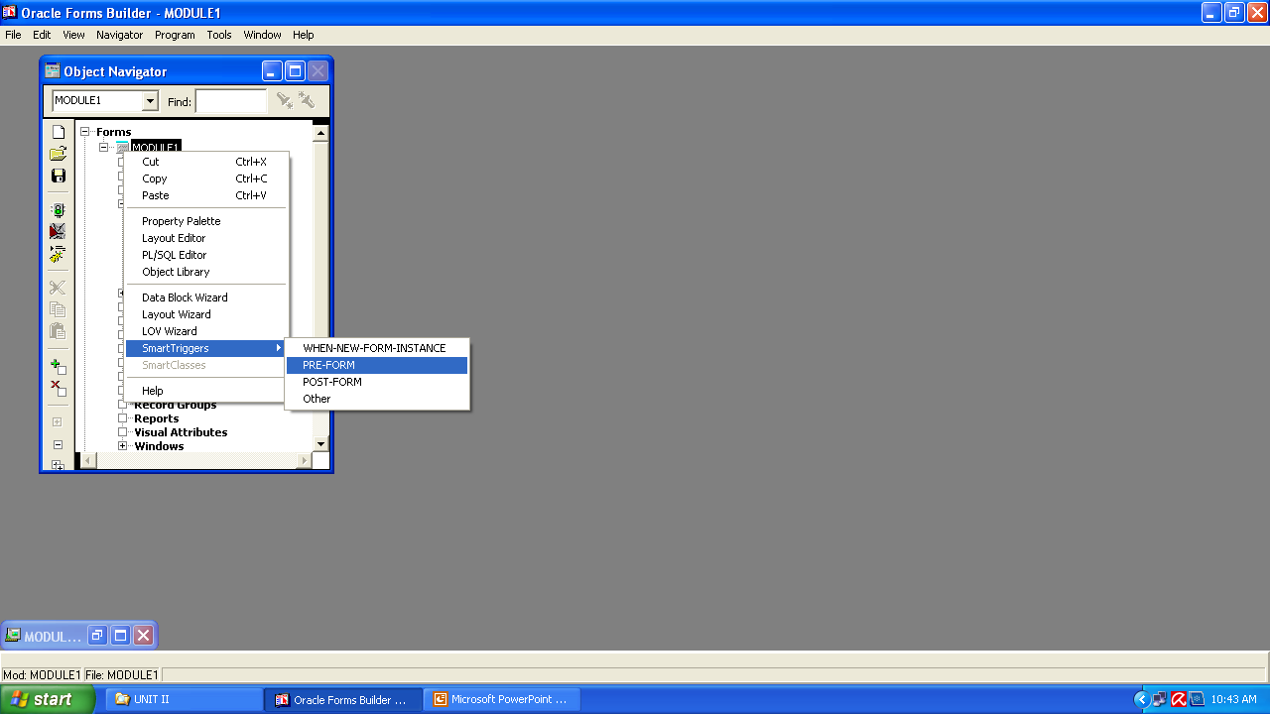

Slide 17

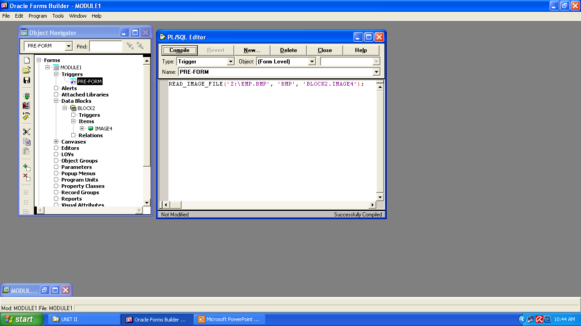
Image location
Type of image file
Created block name. image item name

Slide 18

Open the Property Palette of the Form and change the ‘menu Module’ property as shown in the next slide to the path of the executable menu file.

Slide 19
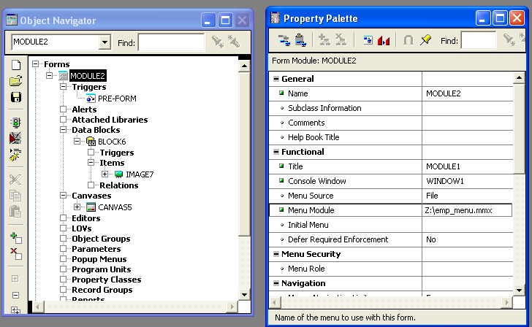

Slide 20

After the form is saved, you can execute and run the application
To exit a form ,the command is
EXIT_FORM;
Note**
Every form being called through the menu items, must have an exit button to close the form

Slide 21

The image is important to add in the parent form because Oracle 6i does not allow any blank canvas to execute.
Even if menu is attached, it takes it be external to the form design so it does not count.
A canvas must have atleast one item.

Slide 22

Display
Locations
Department
Employee
Add
Locations
Department
Employee
Delete
Locations
Department
Employee
Update
Locations
Department
Employee
Exit
EMPLOYEE
MANAGEMENT
SYSTEM

Slide 23
Locations Management
View Locations
Add Location
Remove Location
Edit Location
Exit
LOCATIONS
MANAGEMENT

